Slide 1
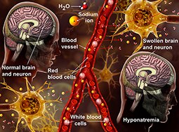
Approach to patient with hyponatremia
Haider A. Alidrisi MD

Slide 2
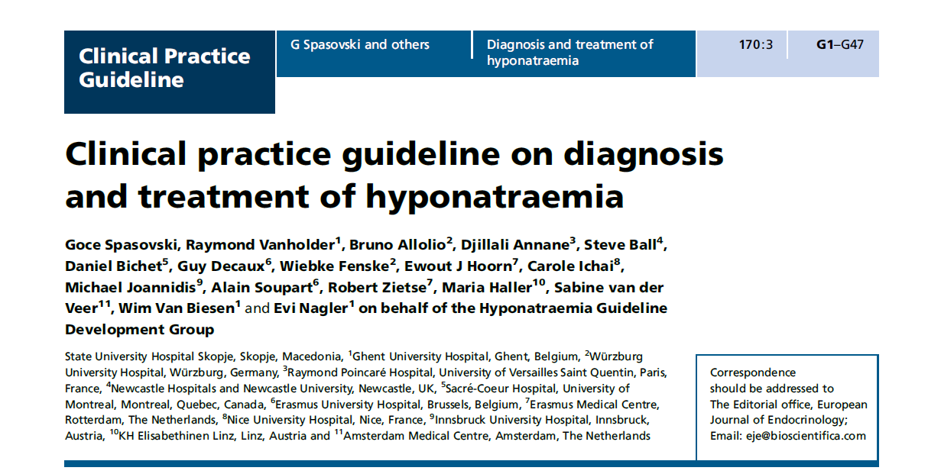

Slide 3
Pathophysiology of hyponatraemia
Hyponatraemia, defined as a serum sodium concentration <135 mmol/l, is the most common disorder of body fluid and electrolyte balance encountered in clinical practice.
It occurs in up to 30% of hospitalized patients and can lead to a wide spectrum of clinical symptoms, from subtle to severe or even life threatening.
Beukhof CM, Hoorn EJ, Lindemans J & Zietse R. Novel risk factors for hospital-acquired hyponatraemia: a matched case–control study. Clinical Endocrinology 2007 66 367–372.
Upadhyay A, Jaber BL & Madias NE. Epidemiology of hyponatremia. Seminars in Nephrology 2009 29 227–238.
Notes:
Hyponatraemia is primarily a disorder of water
balance, with a relative excess of body water compared
to total body sodium and potassium content. It is usually
associated with a disturbance in the hormone that governs
water balance, vasopressin (also called antidiuretic hormone).
Even in disorders associated with (renal) sodium
loss, vasopressin activity is generally required for hyponatraemia
to develop. Therefore, after describing common
signs and symptoms, we detail the mechanisms involved
in vasopressin release.

Slide 4
Pathophysiology of hyponatraemia
Changes in serum osmolality are primarily
determined by changes in the serum concentration of
sodium and its associated anions.
Effective
osmolality or tonicity
Total osmolality
Verbalis JG. Disorders of body water homeostasis. Best Practice & Research. Clinical Endocrinology & Metabolism 2003 17 471–503.

Slide 5
Pathophysiology of hyponatraemia
Total osomality is defined as the concentration of all solutes in a given weight of water (mOsm/kg), regardless of whether or not the osmoles can move across biological membranes.
Effective osmolality or tonicity refers to the number of osmoles that contribute water movement between the intracellular and extracellular compartment. It is a function of the relative solute permeability properties of the membranes separating the intracellular and extracellular fluid compartments
Verbalis JG. Disorders of body water homeostasis. Best Practice & Research. Clinical Endocrinology & Metabolism 2003 17 471–503.

Slide 6
Pathophysiology of hyponatraemia
Only effective solutes create osmotic pressure gradients across cell membranes leading to osmotic movement of water between the intracellular and extracellular fluid compartment.
In most cases, hyponatraemia reflects low effective osmolality or hypotonicity, which causes symptoms of cellular oedema. However, hyponatraemia may also (rarely) occur with isotonic or hypertonic serum if the serum contains many additional osmoles, such as glucose or mannitol.
Verbalis JG. Disorders of body water homeostasis. Best Practice & Research. Clinical Endocrinology & Metabolism 2003 17 471–503.

Slide 7
Estrogen
Progesterone
Androgen
Prolactin
Inhibin
Circadian
rhythm
Stress
Cortisol
↑ Osmolality
Intravascular
volume
Estrogen
Stress
Regulation
T3
IGF-1
-
-
+
+
-
+
-
GHRH
Somatostatin
Posterior
Hypothalamus
GnRH
TRH
Dopamine
CRH
Vasopressin
Oxytocin
+
+
+
-
+
+
+
+_
+
Anterior
Pituitary
LH/FSH
TSH
PRL
GH
ACTH
+
+
+
+
+
Glands
Targets
Testes
Ovaries
Adrenal
cortex
Distal
nephron
Uterus
Breast
Thyroid
Breast
Liver
+
+
+
+
+
+
+
Estrogen
Progesterone
androgen
IGF-1
IGF-1BP
Cortisol
Androgen
Target hormones
T4
T3
+
+
+
+
Function
Reproduction
Metabolism
Lactation
Growth
Stress
metabolism
Water
balance
Parturition
lactation

Slide 8
Regulation of water intake and homeostasis
The major mechanisms responsible for regulating water metabolism are thirst and the pituitary secretion and renal effects of vasopressin.
Osmoregulation.
Baroregulation.
Unregulated vasopressin release. (SIADH)
Syndrome of inappropriate antidiuresis (SIAD).
Renal actions of vasopressin.
Notes:
Unregulated vasopressin release.
The posterior pituitary is the only organ in which
regulated vasopressin release takes place. Under pathological
conditions, both pituitary and other cells may also
synthesise and secrete vasopressin independent of serum
osmolality or circulating volume. Originally, Schwartz &
Bartter (29) introduced the term syndrome of inappropriate
antidiuretic hormone secretion (SIADH) as an
overarching term.
Renal action
The high osmolality of the medulla
provides the driving force needed for re-absorption of
water from the collecting duct. Thanks to the counter
current configuration of the loops of Henle, the kidney is
able to create solute gradients from the cortex to the inner
medulla. Because of the re-absorption of both sodium
and urea from the lumen, the osmolality of the tip of
the medulla may reach 1200 mOsm/l in case of water
depletion. The medullary osmolality determines maximum
urine osmolality and is influenced by vasopressin.

Slide 9
Regulation of water intake and homeostasis
Antidiuretic hormone binds to receptors on cells in the collecting ducts of the kidney and promotes reabsorption of water back into the circulation.
Notes:
Osmoreceptive neurons located in the anterior hypothalamus
detect changes in cell stretch due to changes
in systemic effective osmolality. A decrease in cell stretch
increases the firing rate of osmoreceptive neurons, which
leads to both increased thirst and increased release of
vasopressin from the pituitary gland. Vasopressin in turn
increases the re-absorption of water from the primitive
urine in the distal tubules of the nephron, which leads
to urine that is more concentrated. To prevent persistent
thirst, the threshold for releasing vasopressin is lower than
that for triggering thirst.
Central osmoreceptors, expressing transient receptor
potential vanilloid 1 (TRPV1), and peripheral osmoreceptors,
expressing TRPV4, relay the information on osmolality
(20, 21). The stretch-inactivating cationic TRPV1 and
TRPV4 channels transduce osmotically evoked changes in
cell volume into functionally relevant changes in membrane
potential. TRPV1 is an osmotically activated
channel expressed in the vasopressin producing magnocellular
cells and in the circumventricular organs (22, 23).
Recently, afferent neurons expressing the osmotically
activated ion channel TRPV4 (able to detect physiological
hypo-osmotic shifts in blood osmolality) have been
identified in the thoracic dorsal root ganglia, which
innervate hepatic blood vessels (21).
Stretch-sensitive receptors in the left atrium, carotid sinus
and aortic arch sense circulating volume. When the
circulating volume is increased, afferent neural impulses
inhibit the secretion of vasopressin (12). Conversely, when
the volume is decreased, the discharge rate of the stretch
receptors slows and vasopressin secretion increases (24).
Reductions in blood pressure as little as 5% increase
the serum vasopressin concentration (25). In addition,
there seems to be an exponential association between
the serum vasopressin concentration and the percentage
decline in mean arterial blood pressure, with faster
increases as blood pressure progressively decreases.

Slide 10
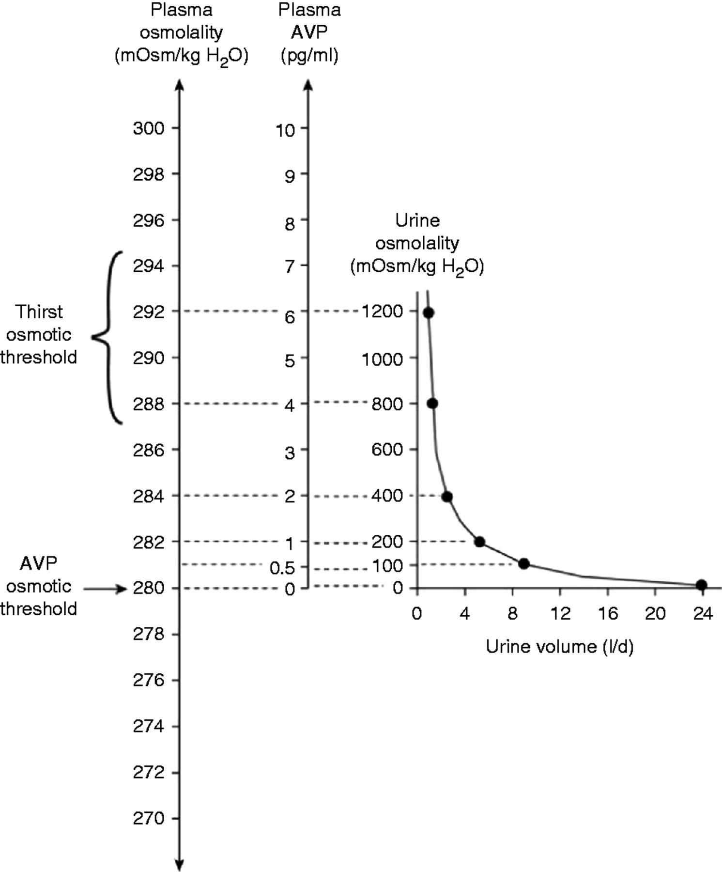
Osmotic stimulation of vasopressin release. Schematic representation of normal physiological relationships among plasma osmolality, plasma AVP concentrations, urine osmolality and urine volume in man. Note particularly the inverse nature of the relationship between urine osmolality and urine volume, resulting in disproportionate effects of small changes in plasma AVP concentrations on urine volume at lower AVP levels. Reproduced with permission from Elsevier Copyright © 2003 Verbalis JG. Disorders of body water homeostasis. Best Practice & Research. Clinical Endocrinology & Metabolism 2003 17 471–503.
Notes:
To prevent persistent
thirst, the threshold for releasing vasopressin is lower than
that for triggering thirst.
Because osmoregulated and baroregulated vasopressin
secretion are interdependent, renal water excretion can be
maintained around a lower set point of osmolality under
conditions of moderately decreased circulating volume
(26). As the circulatory hypovolaemia worsens, the serum
vasopressin concentration dramatically increases and
baroregulation overrides the osmoregulatory system.

Slide 11
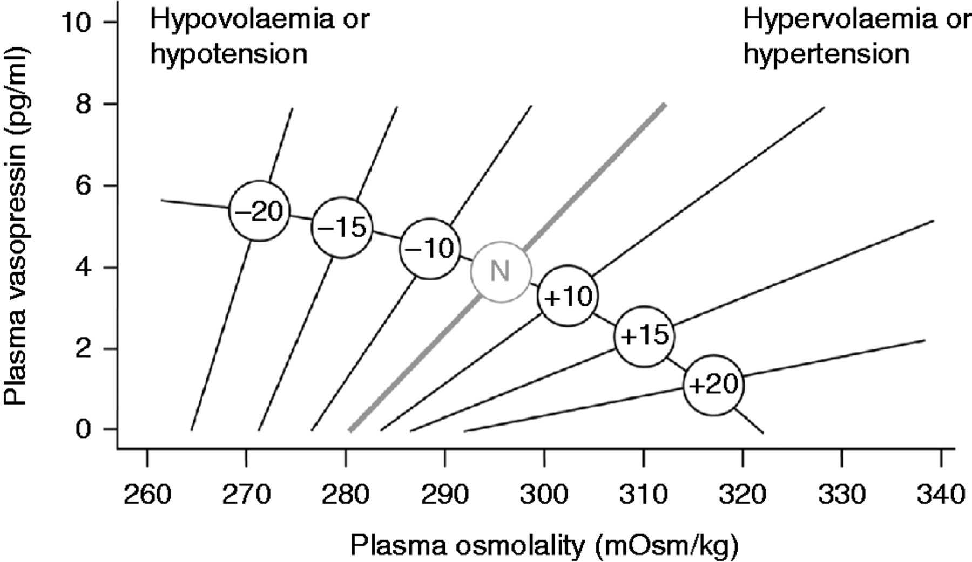
Regulation of water intake and homeostasis
Effects of hypovolaemia on osmoreceptor gain. Reproduced with permission from The Endocrine Society Copyright © 1976 Robertson GL & Athar S. The interaction of blood osmolality and blood volume in regulating plasma vasopressin in man. Journal of Clinical Endocrinology and Metabolism 1976 42 613–620.
Notes:
Because osmoregulated and baroregulated vasopressin
secretion are interdependent, renal water excretion can be
maintained around a lower set point of osmolality under
conditions of moderately decreased circulating volume
(26). As the circulatory hypovolaemia worsens, the serum
vasopressin concentration dramatically increases and
baroregulation overrides the osmoregulatory system.
Modifications
in osmoregulatory gain induced by angiotensin,
together with changes in vasopressin secretion induced
by baroregulation (see below), may explain why the
changes in the slope and threshold of the relationship
between serum osmolality and vasopressin secretion are
potentiated by hypovolaemia or hypotension and are
attenuated by hypervolaemia or hypertension (Fig. 4) (28).

Slide 12
Categories of hyponatraemia according to ECF volume
Hypotonic
Isotonic
Hypertonic

Slide 13
Pseudohyponatraemia
Pseudohyponatraemia is a laboratory artefact that occurs when abnormally high concentrations of lipids or proteins in the blood interfere with the accurate measurement of sodium.
Pseudohyponatraemia was seen more frequently with flame photometric measurement of serum sodium concentration than it is now with ion-selective electrodes, but still occurs.
Turchin A, Seifter JL & Seely EW. Clinical problem-solving. Mind the gap. New England Journal of Medicine 2003 349 1465–1469.
Notes:
Serum osmolality is
measured in an undiluted sample and the result will be
within the normal range in case of pseudohyponatraemia.
If the measurement of serum osmolality is not available,
direct potentiometry using a blood gas analyser will yield
the true sodium concentration, as this measures the
sodium concentration in an undiluted sample too.

Slide 14
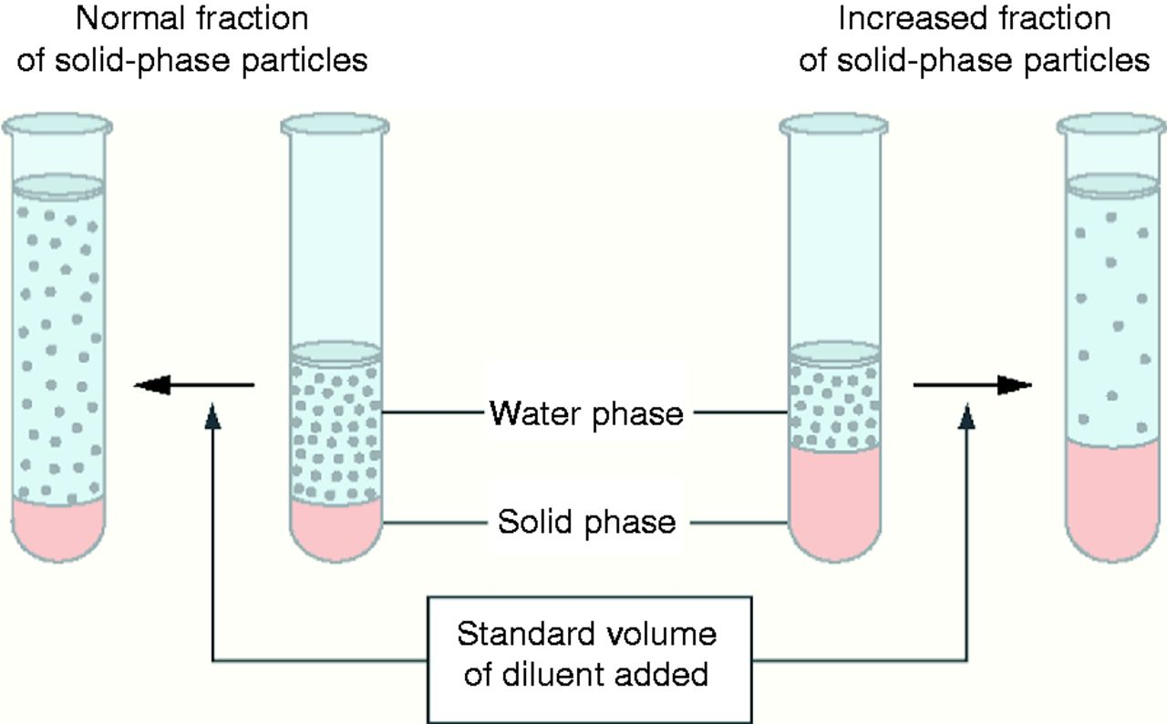
Pseudohyponatraemia
Pseudohyponatraemia. Normally, serum contains 7% solids by volume. In order to reduce the volume of blood needed for analysis, serum is frequently diluted before the actual measurement is obtained. The same volume of diluent is always used; the degree of dilution is estimated under the assumption that the serum contains 7% solid-phase particles. When the fraction of solid-phase particles is increased, the same amount of diluent results in a greater dilution, unbeknownst to the laboratory personnel (right side of figure). Consequently, the calculation of an ion level with the use of a degree of dilution that is based on the incorrect fraction of solid-phase particles will lead to an underestimate. Reproduced with permission from Massachusetts Medical Society Copyright © 2003 Turchin A, Seifter JL & Seely EW. Clinical problem-solving. Mind the gap. New England Journal of Medicine 2003 349 1465–1469.
Notes:
Pseudohyponatraemia. Normally, serum contains 7% solids by volume. In order to reduce the volume of blood needed for analysis, serum is frequently diluted before the actual measurement is obtained. The same volume of diluent is always used; the degree of dilution is estimated under the assumption that the serum contains 7% solid-phase particles. When the fraction of solid-phase particles is increased, the same amount of diluent results in a greater dilution, unbeknownst to the laboratory personnel (right side of figure). Consequently, the calculation of an ion level with the use of a degree of dilution that is based on the incorrect fraction of solid-phase particles will lead to an underestimate. Reproduced with permission from Massachusetts Medical Society Copyright © 2003 Turchin A, Seifter JL & Seely EW. Clinical problem-solving. Mind the gap. New England Journal of Medicine 2003 349 1465–1469.

Slide 15
Case 6
A 25-year-old woman is evaluated in ED after motor vehicle accident. She is 23-weeks’ gestation pregnant.
Physical examination: conscious, pain and bruises over the left chest wall, laceration in forehead, and BP 102/62, PR 80/min.
Labs: s.Na 132 mmol/l
Which of the following is the most likely cause of the low Na?
Excessive water intake
Hypotension induced ADH release
Normal physiology of pregnancy
SIADH

Slide 16
Case 6
A 25-year old woman is evaluated in ED after motor vehicle accident. She is 23-weeks’ gestation pregnant.
Physical examination: conscious, pain and bruises over the left chest wall, laceration in forehead, and BP 102/62, PR 80/min.
Labs: s.Na 132 mmol/l
Which of the following is the most likely cause of the low Na?
Excessive water intake
Hypotension induced ADH release
Normal physiology of pregnancy
SIADH

Slide 17
Case 6
Mild hyponatremia is common in normal pregnancy due to plasma volume increases with water retention (mediated by increase ADH level).
An associated drop in s. osmolality of 8-10, and s. Na of 4-5 mmol/l.
As the mild hypotonic hyponatremia develop, a new set point is maintained.

Slide 18
Reset osmostat
In reset osmostat, there is a change in the set point as well as in the slope of the osmoregulation curve. The response to changes in osmolality remains intact.
We see this phenomenon, for example, in pregnancy where the serum sodium concentration may mildly decrease 4–5 mmol/l.
Verbalis JG. Disorders of body water homeostasis. Best Practice & Research. Clinical Endocrinology & Metabolism 2003 17 471–503.

Slide 19
Isotonic hyponatraemia
Sometimes, the serum contains additional osmoles that increase effective osmolality and reduce the serum sodium concentration by attracting water from the intracellular compartment.
Examples of such osmoles include glucose (hyperglycaemia due to uncontrolled diabetes mellitus), mannitol and glycine (absorption of irrigation fluids during urological or gynaecological surgery).
The resulting ‘translocational’ hyponatraemia is often wrongly considered a form of pseudohyponatraemia.
Hillier TA, Abbott RD & Barrett EJ. Hyponatremia: evaluating the correction factor for hyperglycemia. American Journal of Medicine 1999 106 399–403.
Aviram A, Pfau A, Czaczkes JW & Ullmann TD. Hyperosmolality with hyponatremia, caused by inappropriate administration of mannitol. American Journal of Medicine 1967 42 648–650.
Desmond J. Serum osmolality and plasma electrolytes in patientswho develop dilutional hyponatremia during transurethral resection.
Canadian Journal of Surgery 1970 13 116–121.

Slide 20
Hypertonic hyponatraemia
In hyperglycaemia-induced hyponatraemia, hyponatraemia is caused by dilution due to hyperosmolality. It is important to make the distinction between measured osmolality and effective osmolality.
Effective osmolality (mmol/kg H2O) = 2(serum Na (mmol/l)+serumK(mmol)) + serum glycaemia (mg/dl)/18
This includes only osmoles that are restricted to the extracellular fluid volume. As water returns to the intracellular space during treatment of hyperglycaemia, serum sodium concentration should increase, thus resulting in a constant effective osmolality. If it does not, brain oedema may ensue due to an overly rapid drop in effective osmolality.
Hoorn EJ, Carlotti AP, Costa LA, MacMahon B, Bohn G, Zietse R, Halperin ML & Bohn D. Preventing a drop in effective plasma osmolality to minimize the likelihood of cerebral edema during treatment of children with diabetic ketoacidosis. Journal of Pediatrics 2007 150 467–473.

Slide 21
Hypotonic hyponatraemia
Hypotonic hyponatremia
Low ECF
Normal ECF
High ECF
Notes:
Depletion of circulating volume, with or without deficit
of total body sodium, can markedly increase the
secretion of vasopressin leading to water retention
despite hypotonicity. Although the vasopressin release in this case is inappropriate from an osmoregulatory
point of view, it happens in order to preserve intravascular
volume and can be considered appropriate from a
circulatory point of view.

Slide 22
Hypotonic hyponatraemia with decreased extracellular fluid volume
Non-renal loss
GIT loss: diarrhea, vomting
Skin loss: CF, burn
Notes:
Gastrointestinal sodium loss " Volume depletion
can occur if the body loses sodium through its gastrointestinal
tract. In case of severe diarrhoea, the kidneys
respond by preserving sodium and urine sodium concentrations
are very low. In case of vomiting, metabolic
alkalosis causes renal sodium loss as sodium accompanies
bicarbonate in the urine despite activation of the renin–
angiotensin system. By contrast, in patients with diarrhoea,
chloride accompanies ammonium excreted by the
kidneys in an effort to prevent metabolic acidosis.
This may be caused by impaired
re-absorption of sodium in the sweat duct as in cystic
fibrosis or by an impaired natural barrier function due to
extensive skin burns.

Slide 23
Hypotonic hyponatraemia with decreased extracellular fluid volume
Non-renal loss
GIT loss: diarrhea, vomting
Skin loss: CF, burn
Renal loss
Diuretics
Primary adrenal insufficiency
Cerebral salt wasting
Kidney disease
Notes:
Diuretics and especially thiazides are frequently
implicated as a cause of hyponatraemia. The traditional
explanation is that renal sodium loss leads to volume
contraction with subsequent release of vasopressin.
However, this would require a substantial loss of sodium
and body weight, while patients with thiazide-induced
hyponatraemia often have increased body weight (38).
It might be reasonable to assume that thiazides directly
induce the release of vasopressin or increase the response
of the collecting duct to circulatory vasopressin.
Loop diuretics only rarely cause hyponatraemia
because they reduce osmolality in the renal medulla
and thus limit the kidney’s ability to concentrate urine.
In primary adrenal
insufficiency, hypoaldosteronism causes renal sodium
loss, contracted extracellular fluid volume and hyponatraemia.
Renal sodium loss has been
documented in patients with intracranial disorders such
as subarachnoid bleeding. This renal salt wasting has
been rather confusingly named ‘cerebral’ salt wasting,
and increased levels of brain natriuretic peptide have been
implicated in its pathogenesis (41). Because diagnosis
may be difficult, and both inappropriate antidiuresis
and secondary adrenal insufficiency are actually more
common in this clinical setting, cerebral salt wasting
may be over diagnosed (42). Nevertheless, the recognition of cerebral salt wasting is important because its treatment
requires volume resuscitation rather than water
restriction.
Renal salt wasting can also occur
in kidney dysfunction. The so-called salt-losing nephropathies,
such as tubulopathy after chemotherapy or in
analgesic nephropathy, medullary cystic kidney disease
and certain pharmacological compounds can inhibit
the kidney’s ability to re-absorb appropriate amounts of
sodium

Slide 24
Hypotonic hyponatraemia with decreased extracellular fluid volume
Non-renal loss
GIT loss: diarrhea, vomting
Skin loss: CF, burn
Renal loss
Diuretics
Primary adrenal insufficiency
Cerebral salt wasting
Kidney disease
Third spacing
Bowel obstruction,
pancreatitis,
sepsis or muscle trauma
Notes:
Bowel obstruction, pancreatitis, sepsis or muscle trauma
may markedly reduce effective circulating blood volume
through fluid leakage from blood vessels. This causes
baroreceptor activation and vasopressin release, which
may result in hyponatraemia. Infusion of hypotonic fluids
in this case may worsen hyponatraemia.

Slide 25
Hypotonic hyponatraemia with normal extracellular fluid volume
SIAD, SAIDH
Secondary adrenal insufficiency
Hypothyroidism
High water and low solute intake
Notes:
Euvolaemic hyponatraemia is caused by an absolute
increase in body water, which results from an excessive
fluid intake in the presence of an impaired free water
excretion, either due to inappropriate release of vasopressin
or due to a low intake of solutes.
Secondary adrenal insufficiency is
caused by reduced or absent secretion of adrenocorticotrophic
hormone, resulting in hypocortisolism. Under
normal circumstances, cortisol suppresses both production
of corticotrophin-releasing hormone and
vasopressin in the hypothalamus. In secondary adrenal
insufficiency, persistently low concentrations of cortisol
fail to suppress vasopressin and hyponatraemia results
from impaired free water excretion, as it does in SIAD
hypothyroidism very rarely causes hyponatraemia (49).
In 2006, Warner et al. (50) observed that serum sodium
concentration decreased by 0.14 mmol/l for every 10 mU/l
rise in thyroid-stimulating hormone, indicating that only
severe cases of clinically manifest hypothyroidism resulted
in clinically important hyponatraemia. Development of
hyponatraemia may be related to myxoedema, resulting
from a reduction in cardiac output and glomerular
filtration rate
High water and low solute intake
Vasopressin activity is absent, which is
reflected by an appropriately low urine osmolality, usually
!100 mOsm/kg. Patients with primary polydipsia drink
more than what the kidneys can eliminate. Primary
polydipsia may occur in combination with psychiatric
disorders such as schizophrenia.
Depending on the kidney’s ability to dilute
urine, 50–100 mmol of solutes, such as urea and salts, are
required to remove 1 l offluid. If solute intake is low relative
to water intake, the number of available osmoles can be
insufficient to remove the amount of water ingested. This is
seen in patients with anorexia (nervosa), beer potomania
and so-called ‘tea and toast’ hyponatraemia

Slide 26
Syndrome of inappropriate antidiuresis
SIADH is inappropriate vasopressin secretion because it occurs independently from effective serum osmolality or circulating volume. It may result from increased release by the pituitary gland or from ectopic production.
SIAD may also result from increased activity of vasopressin in the collecting duct or from a gain-of-function mutation in its type 2 receptor.
In SIAD, antidiuresis causes progressive hyponatraemia until the expression of vasopressin V2 receptors and aquaporin-2 water channels is down-regulated, a process appropriately called ‘vasopressin escape’

Slide 27
Dx criteria for Syndrome of inappropriate antidiuresis
Essential criteria
Effective serum osmolality <275 mOsm/kg
Urine osmolality >100 mOsm/kg at some level of decreased
effective osmolality
Clinical euvolaemia
Urine sodium concentration >30 mmol/l with normal dietary
salt and water intake
Absence of adrenal, thyroid, pituitary or renal insufficiency
No recent use of diuretic agents
Diagnostic criteria for the syndrome of inappropriate antidiuresis. Adapted from Schwartz WB, Bennett W, Curelop S & Bartter FC. A syndrome of renal sodium loss and hyponatremia probably resulting from inappropriate secretion of antidiuretic hormone. American Journal of Medicine 1957 23 529–542 (29) and Janicic N & Verbalis JG. Evaluation and management of hypo-osmolality in hospitalized patients. Endocrinology and Metabolism Clinics of North America 2003 32 459–481, vii. (242)

Slide 28
Dx criteria for Syndrome of inappropriate antidiuresis
Supplemental criteria
Serum uric acid <0.24 mmol/l (<4 mg/dl)
Serum urea <3.6 mmol/l (<21.6 mg/dl)
Failure to correct hyponatraemia after 0.9% saline infusion
Correction of hyponatraemia through fluid restriction
Fractional sodium excretion >0.5%
Fractional urea excretion >55%
Fractional uric acid excretion >12%
Diagnostic criteria for the syndrome of inappropriate antidiuresis. Adapted from Schwartz WB, Bennett W, Curelop S & Bartter FC. A syndrome of renal sodium loss and hyponatremia probably resulting from inappropriate secretion of antidiuretic hormone. American Journal of Medicine 1957 23 529–542 (29) and Janicic N & Verbalis JG. Evaluation and management of hypo-osmolality in hospitalized patients. Endocrinology and Metabolism Clinics of North America 2003 32 459–481, vii. (242)
Notes:
Supplemental criteria
Serum uric acid !0.24 mmol/l (!4 mg/dl)
Serum urea !3.6 mmol/l (!21.6 mg/dl)
Failure to correct hyponatraemia after 0.9% saline infusion
Fractional sodium excretion O0.5%
Fractional urea excretion O55%
Fractional uric acid excretion O12%
Correction of hyponatraemia through fluid restriction

Slide 29
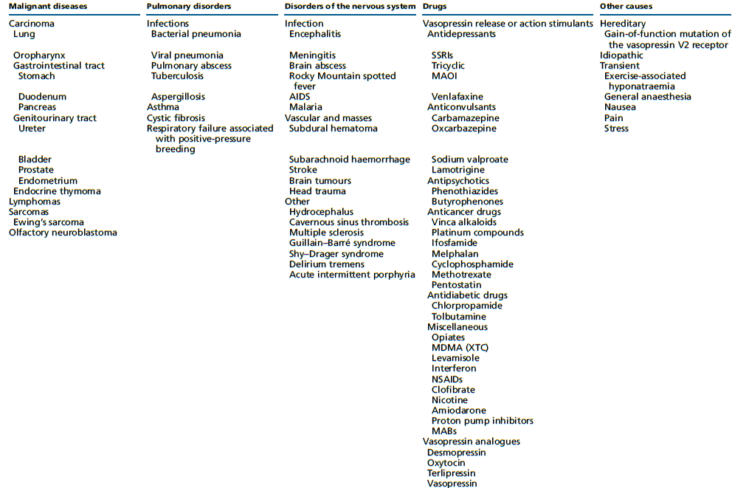
Causes of Syndrome of inappropriate antidiuresis
Adapted from Liamis G, Milionis H and Elisaf M. A review of drug-induces hyponatraemia. American Journal of Kidney Diseases 2008 52 144–153. (247)

Slide 30
Hypotonic hyponatraemia with increased extracellular fluid volume
Kidney disease
Low GFR or tubular injury affect urine dilution and free water excretion leading to isosthenuria. AVP !!!
Heart failure
20–30% of patients with chronic heart failure New York Heart Association (NYHA) classes III and IV have hyponatraemia . It is associated with more severe heart failure and an increased risk of death
Liver failure
Also in liver failure, hyponatraemia is associated with poorer survival
Nephrotic syndrome
Blood volume may be decreased due to the lower serum oncotic pressure (under-fill hypothesis).
Notes:
Kidney disease Free water removal is no longer
regulated by vasopressin but is determined by the number
of osmoles excreted in the urine (i.e. solute intake).
Consequently, hyponatraemia can readily develop if
patients do not adhere to fluid restriction.

Slide 31
Clinical features of hyponatraemia
Symptoms can vary from mild, non-specific to severe and life-threatening.
Severe symptoms of hyponatraemia are caused by brain oedema and increased intracranial pressure.
Rapidity & severity

Slide 32
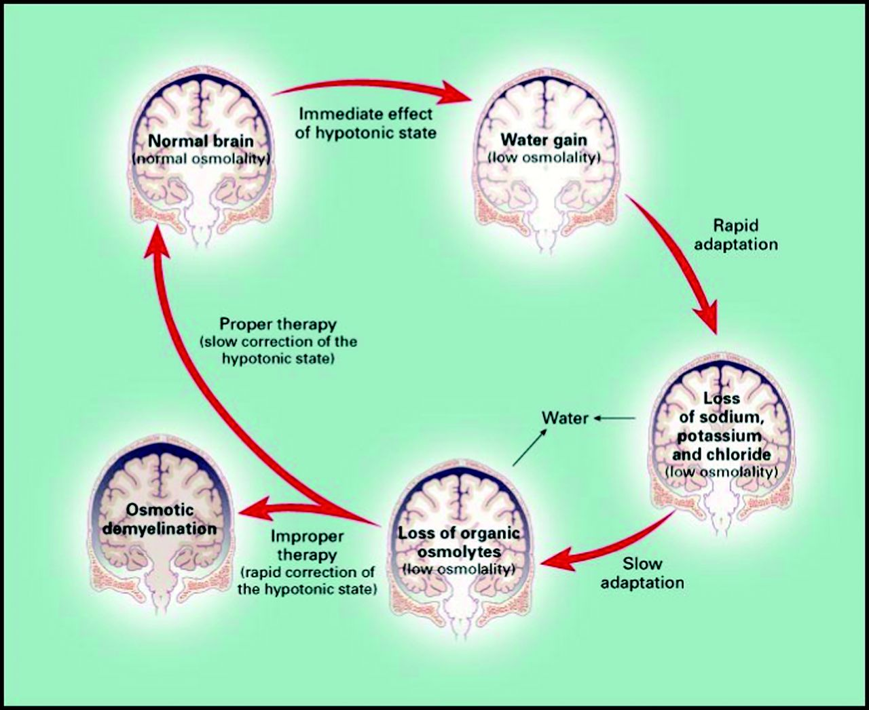
Clinical features of hyponatraemia
Adaptation of the brain to hypotonicity. Reproduced with permission from Massachusetts Medical Society, Copyright © 2000 Adrogue HJ & Madias NE. Hyponatremia. New England Journal of Medicine 2000 342 1581–1589.
Notes:
Brain cells start to swell when
water moves from the extracellular to the intracellular compartment because of a difference in effective osmolality
between brain and plasma. This usually occurs
when hyponatraemia develops rapidly, and the brain
has had too little time to adapt to its hypotonic environment.
Over time, the brain reduces the number of
osmotically active particles within its cells (mostly
potassium and organic solutes) in an attempt to restore
the brain volume (Fig. 2). This process takes w24–48 h,
hence the reason for using the 48-h threshold to distinguish
acute (!48 h) from chronic (R48 h) hyponatraemia.

Slide 33
Clinical features of hyponatraemia
Renneboog B, Musch W, Vandemergel X, Manto MU & Decaux G. Mild chronic hyponatremia is associated with falls, unsteadiness, and
attention deficits. American Journal of Medicine 2006 119 71.e1–71.e8.
Gankam Kengne F, Andres C, Sattar L, Melot C & Decaux G. Mild hyponatremia and risk of fracture in the ambulatory elderly. QJM: Monthly Journal of the Association of Physicians 2008 101 583–588.
Hoorn EJ, Rivadeneira F, vanMeurs JB, Ziere G, Stricker BH, Hofman A, Pols HA, Zietse R, Uitterlinden AG & Zillikens MC. Mild hyponatremia as a risk factor for fractures: the Rotterdam Study. Journal of Bone and Mineral Research 2011 26 1822–1828.
Verbalis JG, Barsony J, Sugimura Y, Tian Y, Adams DJ, Carter EA & Resnick HE. Hyponatremia-induced osteoporosis. Journal of Bone and Mineral Research 2010 25 554–563.
Liamis G, Rodenburg EM, Hofman A, Zietse R, Stricker BH & Hoorn EJ. Electrolyte disorders in community subjects: prevalence and risk factors. American Journal of Medicine 2013 126 256–263.
Wald R, Jaber BL, Price LL, Upadhyay A & Madias NE. Impact of hospital-associated hyponatremia on selected outcomes. Archives of Internal Medicine 2010 170 294–302. Hoorn EJ & Zietse R. Hyponatremia and mortality: moving beyond associations. American Journal of Kidney Diseases 2013 62 139–149.

Slide 34
Clinical features of hyponatraemia
Mild
Gait disturbances, falls, cognitive deficits, osteoporosis?, higher mortality?
Moderate
Nausea without vomiting Confusion, Headache
Severe
Vomiting
Cardiorespiratory distress
Abnormal and deep somnolence
Seizures
Coma (Glasgow Coma Scale <8)

Slide 35
Diagnosis of hyponatraemia “Definitions”
Biochemical
Mild 130-135 mmol/l by specific electrode.
Mod 125-129 mmol/l by specific electrode.
Time
Acute < 48 hrs
Chronic ≥ 48 hrs
Unclassified
Profound <125 mmol/l by specific electrode.
Symptoms
Moderately symptomatic
Severely symptomatic

Slide 36
Case 4
A 20-year-old man is evaluated in the hospital because of generalized tonic-clonic seizure. His friend stated that the patient took 3,4 methylenedioxymethamphetamine (ectasy) several hours earlier.
Physical examination: unresponsive to painful stimuli, no focal neurological signs
BP 90/50, PR 110/min, temp 37.8
Labs on admission were normal
?
Labs | Value
Na | 118 mmol/l
K | 4.1 mmol/l
Cl | 90 mmol/l
HCO3 | 19 mmol/l
Urea | 18 mg/dl
Creatinine | 12 mg/dl

Slide 37
Drugs and conditions associated with acute hyponatraemia
(<48 h)
Drugs and conditions associated with acute hyponatraemia(<48 h)
Postoperative phase
Post-resection of the prostate, post-resection of endoscopic uterine surgery
Polydipsia
Exercise
Recent thiazides prescription
3,4-Methylenedioxymethamfetamine (MDMA, XTC)
Colonoscopy preparation
Cyclophosphamide (i.v.)
Oxytocin
Recently started desmopressin therapy
Recently started terlipressin, vasopressin

Slide 38
Confirming hypotonic and excluding non-hypotonic hyponatraemia
We recommend excluding hyperglycaemic hyponatraemia by measuring the serum glucose concentration and correcting the measured serum sodium concentration for the serum glucose concentration if the latter is increased (1D).
Hyponatraemia with a measured osmolality <275 mOsm/kg always reflects hypotonic hyponatraemia (not graded).
Accept as ‘hypotonic hyponatraemia’ a hyponatraemia without evidence for causes of non-hypotonic hyponatraemia
Notes:
Non-hypotonic hyponatraemia does not cause brain
oedema and is managed differently from hypotonic
hyponatraemia.

Slide 39
Association between serum glucose concentration, measured serum sodium and corrected serum sodium concentration.
Calculated using equation from Hillier TA, Abbott RD & Barrett EJ. Hyponatremia: evaluating the correction factor for
hyperglycemia. American Journal of Medicine 1999 106 399–403.
Notes:
Non-hypotonic hyponatraemia does not cause brain
oedema and is managed differently from hypotonic
hyponatraemia.

Slide 40
Advice for clinical practice
This translates into adding 2.4 mmol/l to the measured serum sodium concentration for every 5.5 mmol/l (100 mg/dl) incremental rise in serum glucose concentration above a standard serum glucose concentration of 5.5 mmol/l (100 mg/dl).
Hillier TA, Abbott RD & Barrett EJ. Hyponatremia: evaluating the correction factor for hyperglycemia. American Journal of Medicine 1999 106 399–403.
Notes:
Non-hypotonic hyponatraemia does not cause brain
oedema and is managed differently from hypotonic
hyponatraemia.

Slide 41
Causes of non-hypotonic hyponatraemia.
Setting | S. osmolality | Examples
Presence of ‘effective’ osmoles that raise serum osmolality and can cause hyponatraemia | Isotonic or hypertonic | Glucose Mannitol Glycine Histidine–tryptophan–ketoglutarate Hyperosmolar radiocontrast media Maltose
Presence of ‘ineffective’ osmoles that raise serum osmolality but do not cause hyponatraemia | Isotonic or hyperosmolar | Urea Alcohols Ethylene glycol
Presence of endogenous solutes that cause pseudohyponatraemia (laboratory artifact) | Isotonic | Triglycerides, cholesterol and protein Intravenous immunoglobulins Monoclonal gammapathies

Slide 42
Which parameters to be used for differentiating hypotonic hyponatraemia

Slide 43
Case 1
A 49 years old man, fell at home and brought by the ambulance.
Chronic alcohol consumption.
Clinical status:
Disoriented,
Clinical euvolumia
Labs | Value
Na | 117 mmol/l
Glucose | 95 mg/dl
S.Osmolality | 237 mosm/kg
U.Osmolality | 509 mosm/kg
TSH | 2 mU/l
Cortisol | 12 Mg/l

Slide 44
Case 5
A 48-year-old woman is evaluated in ED for a 1-day hearing voices. History is significant for bipolar disorder on lithium and quetiapine.
Physical examination: disheveled and chronically ill, alert, oriented but anxious. BP 138/78 with no postural drop.

Slide 45
Case 5
Current labs
Labs | Value
BUN | 6 mg/dl
Creatinine | 0.9 mg/dl
Na | 126 mmol/l
Glucose | 156 mg/dl
K | 3.5 mmol/l
Cl | 91 mmol/l
HCO3 | 26 mmol/l
Uric acid | 6.8 mg/dl
S. Osmolality | 248 mosm/kg
U. Osmolality | 96 mosm/kg
U. Na | 12 mmol/l

Slide 46
Case 5
Which of the following is the most likely cause of this patient’s hyponatremia?
Hyperglycemia
Nephrogenic DI
Polydipsia
SIADH
Volume depletion.

Slide 47
Which parameters to be used for differentiating hypotonic hyponatraemia

Slide 48
Which parameters to be used for differentiating hypotonic hyponatraemia
Urine osmolality
Urine Na
ADH!!
Volume status
Water load
Other labs
It is important to collect the serum and urine sample around the same time to allow correct interpretation of the values.

Slide 49
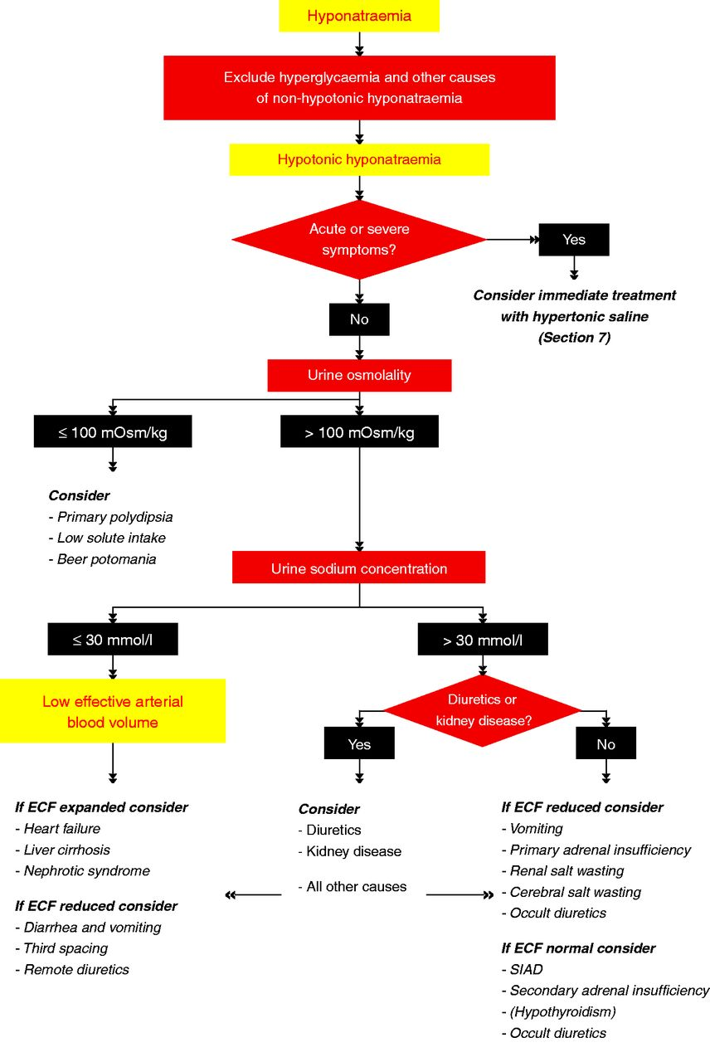
Algorithm for the diagnosis of hyponatraemia

Slide 50
Algorithm for the diagnosis of hyponatraemia

Slide 51
Diagnostic difficulty with diuretics
These medications can Increased, normal or decreased extracellular and circulating volume and can have increased or decreased urine sodium concentration, depending on the timing of the most recent tablet, irrespective of their underlying volume status.
The natriuresis Induced by diuretics may cause ‘appropriate’ vasopressin release and subsequently hyponatraemia because of a decrease in circulating volume.
Finally, diuretics may cause a SIAD-like state characterized by normal or mildly increased extracellular fluid volume
Friedman E, Shadel M, Halkin H & Farfel Z. Thiazide-induced hyponatremia. Reproducibility by single dose rechallenge and an analysis of pathogenesis. Annals of Internal Medicine 1989 110 24–30.
Hamburger S, Koprivica B, Ellerbeck E & Covinsky JO. Thiazideinduced syndrome of inappropriate secretion of antidiuretic hormone. Time course of resolution. Journal of the American Medical Association 1981 246 1235–1236.

Slide 52
Diagnostic difficulty with diuretics
In patients using diuretics, a fractional excretion of uric acid <12% may be better than urine sodium concentration to differentiate reduced effective circulating volume from SIAD as the underlying cause of hyponatraemia, although this assertion needs further confirmation.
We suggest that in patients taking diuretics, the diuretics be considered a contributing factor to hyponatraemia.
Most common with thiazide diuretics, potassium-sparing diuretics such as mineralocorticoid may also cause hyponatraemia, and it occurs less frequently with loop.
Fenske W, Stork S, Koschker AC, Blechschmidt A, Lorenz D, Wortmann S & Allolio B. Value of fractional uric acid excretion in differential diagnosis of hyponatremic patients on diuretics. Journal of Clinical Endocrinology and Metabolism 2008 93 2991–2997.
Sonnenblick M, Friedlander Y & Rosin AJ. Diuretic-induced severe hyponatremia. Review and analysis of 129 reported patients. Chest 1993 103 601–606.
Liamis G, Rodenburg EM, Hofman A, Zietse R, Stricker BH & Hoorn EJ. Electrolyte disorders in community subjects: prevalence and risk factors. American Journal of Medicine 2013 126 256–263.
Notes:
Loop diuretics because they interfere with the renal concentrating
mechanism

Slide 53
Case 2
A 44-year-old man is evaluated in the hospital because of disorientation and hallucinations. He was admitted to 4 days ago for SAH that was repaired with surgical clipping. His medical Hx is unremarkable.
Physical examination: Disoriented, confused, and hallucinating.
BP 140/80, PR 90/min, on standing BP 120/60, PR 110/min
Labs on admission were normal

Slide 54
Case 2
Current labs
Labs | Value
Na | 118 mmol/l
Glucose | 97 mg/dl
K | 4.1 mmol/l
Cl | 85 mmol/l
HCO3 | 23 mmol/l
Uric acid | 6.8 mg/dl
S. Osmolality | 248 mosm/kg
U. Osmolality | 633 mosm/kg
U. Na | 105 mmol/l
U. K | 20 mmol/l
U. Cl | 90 mmol/l

Slide 55
Case 2
Which of the following is the most likely cause of this patient’s hyponatremia?
Adrenal insufficiency
Cerebral salt wasting
Hypothyroidism
SIADH

Slide 56
Case 2
Which of the following is the most likely cause of this patient’s hyponatremia?
Adrenal insufficiency
Cerebral salt wasting
Hypothyroidism
SIADH

Slide 57
Case 2
CSW is a rare cause of hyponatremia. Typically occurs within few days of neurosurgical procedure or SAH.
Labs include low Na, low or low normal p. osmolality, elevated u. osmolality, and elevated urine Na relative to the hyponatremia.
The presence of orthostasis or hypotension.
Adrenal insufficiency would explain, but history not suggestive. Hyperkalemia and a mild non-anion gap acidosis are found in 60% of the patients.

Slide 58
Cerebral salt wasting
 | SIADH | Cerebral salt wasting
Serum urea | Normal-low | Normal-high
Serum uric acid | Low | Low
Urine volume | Normal-low | High
Urine Na | >30 mmol/l | >>30 mmol/l
Blood pressure | Normal | Normal-orthostasis
CVP | Normal | low
Adapted from Sherlock M, O’Sullivan E, Agha A, Behan LA, Rawluk D, Brennan P, Tormey W& Thompson CJ. The incidence and pathophysiology of hyponatraemia after subarachnoid haemorrhage. Clinical Endocrinology 2006 64 250–254.

Slide 59
Treatment of hypotonic hyponatraemia
?
?
?

Slide 60
Case 3
A 22-year-old woman is evaluated at ED after collapsing while running a marathon. She was disoriented, and during evaluation he developed generalized tonic-clonic seizure for 3 minutes. A wristband indicates he has diabetes.
Physical examination: BP 120/60, PR 100/min, no edema, normal CPE. Apart from confusion, there was no focal neurological signs.
Labs | Value
Na | 118 mmol/l
Glucose | 120 mg/dl

Slide 61
Case 3
Which of the following is the most appropriate next step in this patient management?
Normal saline infusion
50% glucose infusion
3% saline infusion
IV furosemide
Vasopressin receptor antagonist

Slide 62
Case 3
Which of the following is the most appropriate next step in this patient management?
Normal saline infusion
50% glucose infusion
3% saline infusion
IV furosemide
Vasopressin receptor antagonist

Slide 63
Case 3
Acute exercise-induced hyponatremia, and the most appropriate next step is 3% saline infusion, 100 ml over 10 minutes.
An increase in fluid consumption is the primary risk factor, besides female gender, low BMI, lack of athletic training.
Most hyponatremic athletes are asymptomatic or have mild symptoms including nausea, dizziness, weakness, and headache. But severe manifestations lead to confusion, seizure, collapse, and coma.
Hypo or isotonic saline may be helpful in mild hyponatremia and volume depletion. But should be avoided in acute severe hyponatremia, as it will exacerbate more hyponatremia.

Slide 64
Which of the following is true regarding hyponatremia?
Hyponatremia is more common among men.
The reference range for serum sodium is 145-155 mEq/L
A serum sodium level <105 mEq/L is associated with a mortality rate >50%
Chronic hyponatremia can be safely corrected more quickly than acute hyponatremia
Notes:
Severe hyponatremia (<125 mEq/L) has a high mortality rate. In instances when the serum sodium level is <105 mEq/L, the mortality is >50%, especially in alcoholics. No sexual predilection exists for hyponatremia. However, symptoms are more likely to occur in young women than in men. The normal serum sodium level is 135-145 mEq/L. Acute hyponatremia (duration <48 hours) can be safely corrected more quickly than chronic hyponatremia. Correction of serum sodium that is too rapid can precipitate severe neurologic complications.

Slide 65
Treatment of hypotonic hyponatraemia
?
?
?

Slide 66
Treatment of hypotonic hyponatraemia
Time
Severity
ECF
Acute or chronic
Mild or moderate or severe
Reduced or normal or expanded

Slide 67
Treatment of hypotonic hyponatraemia
Severe
yes
No
moderate
yes
No
Acute
yes
No
↓ECF
yes
No
↑ECF
yes
No
Rx as acute, non mod or severe
Rx as severe
Rx as mod
Rx as ↓ECF
Rx as ↑ECF
SIAD

Slide 68
Hyponatraemia with severe symptoms
First-hour management, regardless of whether hyponatraemia is acute or chronic
We recommend prompt i.v. infusion of 150 ml 3% hypertonic over 20 min (1D).
We suggest checking the serum sodium concentration after 20 min while repeating an infusion of 150 ml 3% hypertonic saline for the next 20 min (2D).
We suggest repeating therapeutic recommendations twice or until a target of 5 mmol/l increase in serum sodium concentration is achieved (2D).
Manage patients with severely symptomatic hyponatraemia in an environment where close biochemical and clinical monitoring can be provided (not graded).

Slide 69
Hyponatraemia with severe symptoms
Follow-up management in case of improvement of symptoms after a 5 mmol/l increase in serum sodium concentration in the first hour, regardless of whether hyponatraemia is acute or chronic
We recommend stopping the infusion of hypertonic saline (1D).
We recommend keeping the i.v. line open by infusing the smallest feasible volume of 0.9% saline until cause-specific treatment is started (1D).
We recommend starting a diagnosis-specific treatment if available, aiming at least to stabilise sodium concentration (1D).
We recommend limiting the increase in serum sodium concentration to a total of 10 mmol/l during the first 24 h and an additional 8 mmol/l during every 24 h thereafter until the serum sodium concentration reaches 130 mmol/l (1D).
We suggest checking the serum sodium concentration after 6 and 12 h and daily afterwards until the serum sodium concentration has stabilised under stable treatment (2D).

Slide 70
Hyponatraemia with severe symptoms
Follow-up management in case of no improvement of symptoms after a 5 mmol/l increase in serum sodium concentration in the first hour, regardless of whether hyponatraemia is acute or chronic.
We recommend continuing an i.v. infusion of 3% hypertonic saline or equivalent aiming for an additional 1 mmol/l per h increase in serum sodium concentration (1D).
We recommend stopping the infusion of 3% hypertonic saline or equivalent when the symptoms improve, the serum sodium concentration increases 10 mmol/l in total or the serum sodium concentration reaches 130 mmol/l, whichever occurs first (1D).
We recommend additional diagnostic exploration for other causes of the symptoms than hyponatraemia (1D).
We suggest checking the serum sodium concentration every 4 h as long as an i.v. infusion of 3% hypertonic saline or equivalent is continued (2D).

Slide 71
Case 4
A 20-year-old man is evaluated in the hospital because of generalized tonic-clonic seizure. His friend stated that the patient took 3,4 methylenedioxymethamphetamine (ectasy) several hours earlier.
Physical examination: unresponsive to painful stimuli, no focal neurological signs
BP 90/50, PR 110/min, temp 37.8
Labs on admission were normal
Labs | Value
Na | 118 mmol/l
K | 4.1 mmol/l
Cl | 90 mmol/l
HCO3 | 19 mmol/l
Urea | 18 mg/dl
Creatinine | 12 mg/dl

Slide 72
Case 4
Which of the following is the most appropriate next step in this patient management?
IV desmopressin
IV conivaptan
3% saline infusion
IV furosemide
3% saline plus IV conivaptan.

Slide 73
Case 4
Which of the following is the most appropriate next step in this patient management?
IV desmopressin
IV conivaptan
3% saline infusion
IV furosemide
3% saline plus IV conivaptan.

Slide 74
Case 4
MDMA (ectasy) induced acute hyponatremia.
This stimulates thirst and induces ADH secretion.
Decrease GIT motility which can lead to retention of several liters of water in its lumen. This water can be absorbed abruptly once the motility is restored causing sudden severe fatal hyponatremia.
Rapid normalization of ECF osmolality is the rule with hypertonic saline.
Expert opinion believes a combination with vasopressin receptor antagonist is the most appropriate treatment for this condition.

Slide 75
Hyponatraemia with severe symptoms
Advice for clinical practice
Prompt infusion of hypertonic saline may save lives.
Therefore, it may be wise for the pharmacy to store pre-prepared 150 ml bags of 3% hypertonic saline.
Consider using weight-based (2 ml/kg) rather than the fixed 150 ml infusion volumes of 3% hypertonic saline in case of obviously deviant body composition.
Do not expect patients with severe symptoms to completely recover immediately.
Correction of the hypokalaemia will contribute to an increase in serum sodium concentration.
Formula of Adrogue´–Madias. The role of desmopressin!!!
Notes:
It can be speculated that administering
desmopressin makes the Androgue´–Madias formula more
accurate in clinical practice, as it removes one of the
variables during treatment, by clamping urine electrolyte free
water excretion at a constant level. A retrospective
observational study has indicated that combined use of
1–2 mg i.v. desmopressin with hypertonic saline may allow
gradual increase in serum sodium concentration without
risking overcorrection. The study involved physicians
with extensive experience in treating hyponatraemia.

Slide 76
Treatment of hypotonic hyponatraemia
Severe
yes
No
moderate
yes
No
Rx as severe
Rx as mod

Slide 77
Hyponatraemia with moderately severe symptoms
We recommend starting prompt diagnostic assessment (1D).
Stop, if possible, medications and other factors that can contribute to or provoke hyponatraemia (not graded).
We recommend cause-specific treatment (1D).
We suggest immediate treatment with a single i.v. infusion of 150 ml 3% hypertonic saline or equivalent over 20 min (2D).
We suggest aiming for a 5 mmol/l per 24-h increase in serum sodium concentration (2D).
We suggest limiting the increase in serum sodium concentration to 10 mmol/l in the first 24 h and 8 mmol/l during every 24 h thereafter, until a serum sodium concentration of 130 mmol/l is reached (2D).

Slide 78
Hyponatraemia with moderately severe symptoms
We suggest checking the serum sodium concentration after 1, 6 and 12 h (2D).
We suggest additional diagnostic exploration for other causes of the symptoms if the symptoms do not improve with an increase in serum sodium concentration (2D).
We suggest considering to manage the patient as in severely symptomatic hyponatraemia if the serum sodium concentration further decreases despite treating the underlying diagnosis (2D).

Slide 79
Treatment of hypotonic hyponatraemia
Severe
yes
No
moderate
yes
No
Acute
yes
No
Rx as acute, non mod or severe
Rx as severe
Rx as mod

Slide 80
Acute hyponatraemia without severe or moderately severe symptoms
Make sure that the serum sodium concentration has been measured using the same technique used for the previous measurement and that no administrative errors in sample handling have occurred (not graded).
If possible, stop fluids, medications and other factors that can contribute to or provoke hyponatraemia (not graded).
We recommend starting prompt diagnostic assessment (1D).
We recommend cause-specific treatment (1D).
If the acute decrease in serum sodium concentration exceeds 10 mmol/l, we suggest a single i.v. infusion of 150 ml 3% hypertonic saline or equivalent over 20 min (2D).
We suggest checking the serum sodium concentration after 4 h, using the same technique as used for the previous measurement (2D).

Slide 81
Treatment of hypotonic hyponatraemia
Severe
yes
No
moderate
yes
No
Chronic hyponatraemia without severe or moderately severe symptoms
Acute
yes
No
Rx as acute, non mod or severe
Rx as severe
Rx as mod

Slide 82
Chronic hyponatraemia without severe or moderately severe symptoms
Stop non-essential fluids, medications and other contributing factors (not graded).
We recommend cause-specific treatment (1D).
In mild hyponatraemia, we suggest against treatment with the sole aim of increasing the serum sodium concentration (2C).
In moderate or profound hyponatraemia,
We recommend avoiding an increase in serum sodium concentration of >10 mmol/l during the first 24 h and >8 mmol/l during every 24 h thereafter (1D).
We suggest checking the serum sodium concentration every 6 h until the serum sodium concentration has stabilized under stable treatment (2D).
In case of unresolved hyponatraemia, reconsider the diagnostic algorithm and ask for expert advice (not graded).

Slide 83
Treatment of hypotonic hyponatraemia
Severe
yes
No
moderate
yes
No
Chronic hyponatraemia without severe or moderately severe symptoms
Acute
yes
No
↓ECF
yes
No
Rx as acute, non mod or severe
Rx as severe
Rx as mod
Rx as ↓ECF

Slide 84
Patients with reduced circulating volume
We recommend restoring extracellular volume with i.v. infusion of 0.9% saline or a balanced crystalloid solution at 0.5–1.0 ml/kg per h (1B).
Manage patients with haemodynamic instability in an environment where close biochemical and clinical monitoring can be provided (not graded).
In case of haemodynamic instability, the need for rapid fluid resuscitation overrides the risk of an overly rapid increase in serum sodium concentration (not graded).
A sudden increase in urine output to >100 ml/h signals increased risk of overly rapid rise in serum sodium concentration, so measuring the serum sodium concentration every 2 h until it has stabilised under stable treatment.
Notes:
A sudden increase in urine output to O100 ml/h
signals increased risk of overly rapid rise in serum
sodium concentration. If vasopressin activity is suddenly
suppressed, as happens when intravascular
volume is restored in hypovolaemia, free water
clearance can dramatically increase, resulting in
serum sodium concentrations rising more rapidly
than expected. If urine output suddenly increases,
we would advise measuring the serum sodium concentration every 2 h until it has stabilised under
stable treatment. The implicit advice to monitor urine
output does not imply that we advise a bladder
catheter solely for this purpose. Most patients will be
able to void spontaneously and collect urine for
output monitoring.

Slide 85
Treatment of hypotonic hyponatraemia
Severe
yes
No
moderate
yes
No
Chronic hyponatraemia without severe or moderately severe symptoms
Acute
yes
No
↓ECF
yes
No
↑ECF
yes
No
Rx as acute, non mod or severe
Rx as severe
Rx as mod
Rx as ↓ECF
Rx as ↑ECF

Slide 86
Patients with expanded extracellular fluid
We recommend against a treatment with the sole aim of increasing the serum sodium concentration in mild or moderate hyponatraemia (1C).
We suggest fluid restriction to prevent further fluid overload (2D).
We recommend against vasopressin receptor antagonists (1C).
We recommend against demeclocycline (1D).

Slide 87
Treatment of hypotonic hyponatraemia
Severe
yes
No
moderate
yes
No
Chronic hyponatraemia without severe or moderately severe symptoms
Acute
yes
No
↓ECF
yes
No
↑ECF
yes
No
Rx as acute, non mod or severe
Rx as severe
Rx as mod
Rx as ↓ECF
Rx as ↑ECF
SIAD

Slide 88
SIAD
In moderate or profound hyponatraemia,
We suggest restricting fluid intake as first-line treatment (2D).
Equal second line treatments: increasing solute intake with 0.25–0.50 g/kg per day of urea or a combination of low-dose loop diuretics and oral sodium chloride (2D).
We recommend against lithium or demeclocycline (1D).
We do not recommend vasopressin receptor antagonists (1C).
Notes:
Advice
As a means of increasing solute intake, we suggest daily
intake of 0.25–0.50 g/kg urea can be used. The bitter
taste can be reduced by combining it with sweet-tasting
substances. The pharmacist may be asked to prepare
the following as sachets: urea 10 gCNaHCO3 2 gC
citric acid 1.5 gCsucrose 200 mg to be dissolved in
50–100 ml water. This will result in a more palatable,
slightly sparkling solution.
For demeclocycline and lithium, there is some evidence
of possible harm, so we advise against their use for
management of any degree of chronic hyponatraemia in
patients with SIAD.
Although vasopressin receptor antagonists do increase
serum sodium, the guideline development group judged
that based on current evidence, these drugs cannot be
recommended. Indeed, the risk benefit ratio seems to be negative

Slide 89
What to do if hyponatraemia is corrected too rapidly?
We recommend prompt intervention for re-lowering the serum sodium concentration if it increases >10 mmol/l during the first 24 h or >8 mmol/l in any 24 h thereafter (1D).
We recommend discontinuing the ongoing active treatment (1D).
We recommend consulting an expert to discuss if it is appropriate to start an infusion of 10 ml/kg body weight of electrolyte-free water (e.g. glucose solutions) over 1 h under strict monitoring of urine output and fluid balance (1D).
We recommend consulting an expert to discuss if it is appropriate to add i.v. desmopressin 2 mg, with the understanding that this should not be repeated more frequently than every 8 h (1D).

Slide 90
To avoid osmotic demyelination syndrome (ODS) in normal-risk patients with chronic hyponatremia, which of the following is recommended?
Minimum correction of 2-3 mmol/L per day
Minimum correction of 4-8 mmol/L per day
Maximum correction of 8 mmol/L in any 24-hour period
Maximum correction of 20 mmol/L in any 48-hour period
Notes:
To avoid ODS in patients with chronic hyponatremia (known duration >48 hours), the recommendations include the following:
Minimum correction of serum sodium by 4-8 mmol/L per day, with a lower goal of 4-6 mmol/L per day if the risk for ODS is high
For patients at high risk for ODS: maximum correction of 8 mmol/L in any 24-hour period
For patients at normal risk for ODS: maximum correction of 10-12 mmol/L in any 24-hour period and 18 mmol/L in any 48-hour period

Slide 91
Osmotic demyelination syndrome
It seems to depend not only on the speed of increase in serum sodium concentration but also on associated underlying risk factors:
Na<105
Mod risk <120
Hypokalemia
Alcoholism
Malnutrition
Severe liver disease
Thiazides & antidepressants
Limit correction to 4-6 mmol/l
Notes:
To avoid ODS in patients with chronic hyponatremia (known duration > 48 hours), the recommendations include the following:
Minimum correction of serum sodium by 4-8 mmol/L per day, with a lower goal of 4-6 mmol/L per day if the risk for ODS is high
For patients at high risk for ODS: maximum correction of 8 mmol/L in any 24-hour period
For patients at normal risk for ODS: maximum correction of 10-12 mmol/L in any 24-hour period or 18 mmol/L in any 48-hour period

Slide 92
Which of the following is most accurate regarding the presentation of hyponatremia?
Patients with hypovolemic hypotonic hyponatremia rarely present with orthostatic symptoms
Central nervous system (CNS) disturbances (eg, hypopituitarism) are more commonly associated with hypervolemic hypotonic hyponatremia than with normovolemic (euvolemic) hypotonic hyponatremia
Patients whose medical history includes loop diuretics are more likely to develop hyponatremia than are patients who take thiazides
Hyponatremia associated with cortisol deficiency, such as primary or secondary hypoadrenalism, commonly presents subtly and may go undiagnosed
Notes:
Diuretics may induce hypovolemic hyponatremia. Note that thiazide diuretics, in contrast to loop diuretics, impair the diluting mechanism without limiting the concentrating mechanism, thereby impairing the ability to excrete a free water load. Thus, thiazides are more prone to causing hyponatremia than are loop diuretics. This is particularly so in elderly persons, who already have impaired diluting ability.

Slide 93
Which of the following is most accurate regarding symptoms associated with hyponatremia?
Even mild reductions in serum sodium levels frequently cause overt neurologic symptoms
Severe hyponatremia should be considered in pediatric patients who present with symptoms of bacterial meningitis
Constipation is a more common presenting symptom than vomiting in patients with hyponatremia
Symptoms of exercise-associated hyponatremia (EAH) occur only in patients with an underlying unhealthy condition, as opposed to healthy patients
Notes:
A retrospective Chinese study reported hyponatremia in 116 of 175 children (66.4%) with bacterial meningitis. Multivariate analyses showed that convulsions and blood glucose levels > 6.1 mmol/L (> 110 mg/dL) were related to severe hyponatremia. Severe hyponatremia should be considered in pediatric patients with bacterial meningitis who have either of those findings.
Overt neurologic symptoms most often are due to very low serum sodium levels (usually < 115 mEq/L), resulting in intracerebral osmotic fluid shifts and brain edema. This neurologic symptom complex can lead to tentorial herniation with subsequent brain stem compression and respiratory arrest, resulting in death in the most severe cases. Symptoms of hyponatremia range from nausea and malaise with mild reduction in the serum sodium level to vomiting, lethargy, decreased level of consciousness, muscle spasms, headache, and (if severe) seizures and coma.
EAH, which develops during or immediately after physical activity, was first reported in athletes participating in long-duration, high-intensity exercise (eg, ultramarathons) particularly in hot weather, but has since been described in otherwise healthy participants in various sporting and recreational activities, including team sports and yoga classes. EAH results from drinking hypotonic fluids (water or sports drinks) beyond thirst and in excess of sweat, urine, and insensible water losses.

Slide 94
Approach
To
H↑per Na tremia
…………………………………

